Slide 1
Intro to Coding & Website Basics
MSP Ryan Wedoff
University of Iowa

Slide 2
Who is this guy?
Microsoft Student Partner
Host monthly workshop on tech
Loves tech, Microsoft Products and building stuff
First year Master in Computer Science
BS in CS May 2017
ACM President (“Iowa’s Computer Science club”)
Microsoft Intern
Fargo ND Summer 2016
Seattle WA Summer 2017
Notes:
Introduce name!
Who here has coding experience?
Who here has used excel formulas?
What majors is everyone?
What computers do you use?

Slide 3

Peanut Butter and Jelly Activity
Group activity:
I don’t know how to make a PBJ sandwich. I need help!
Notes:
What do this have to do with computer and coding?
Coding is the art of writing a program for the a computer. The computer will do exactly what you tell it to do. Just like the PBJ activity, it will literally do what you tell it to do, even if that is wrong!

Slide 4




How do I code?
Computer reads 110110110110100100100100100100101001001
You don’t need to know binary!
Coding languages eventually (assembly) boil down to 11101101101001001
Programming languages are written in words that are easy to understand
Common programming languages:
Notes:
What do this have to do with computer and coding?
Coding is the art of writing a program for the a computer. The computer will do exactly what you tell it to do. Just like the PBJ activity, it will literally do what you tell it to do, even if that is wrong!

Slide 5
Software you need
Programing requires special software
C#: Visual Studio
Java: Eclipse, IntelliJ, or NetBeans
For any language you can use any text editor (Notepad, TextEdit, or even Word)
Today we will use Visual Studio Code (http://code.visualstudio.com/)
Visual Studio Code is a text editor that can open almost any file and is great for web development.
Notes:
Go through Visual Studio Code install

Slide 6
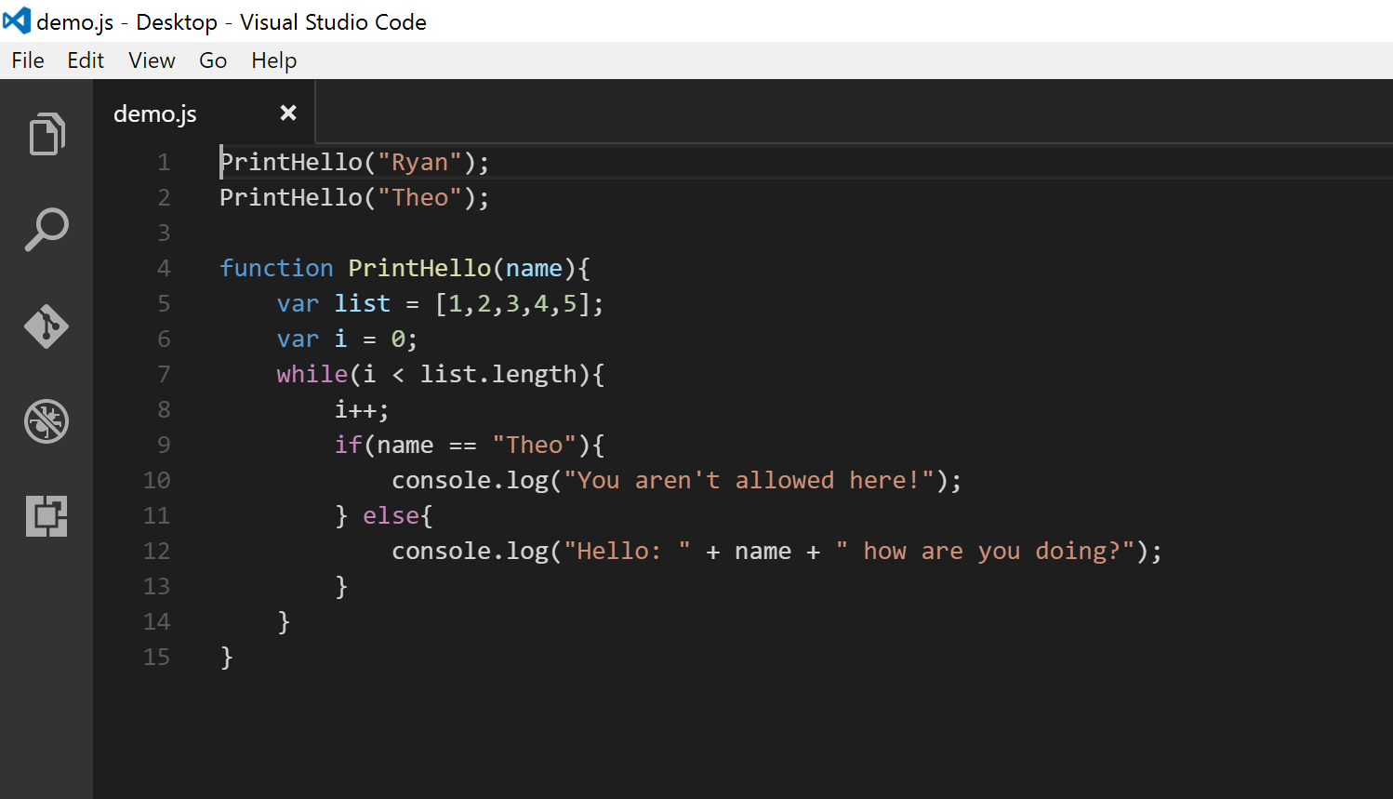
What does code normally look like?
Functions
Variables
Loops (While, For)
If Else Statement
String
Math
Notes:
Walk through code and run it!

Slide 7
Website Basics!

Slide 8
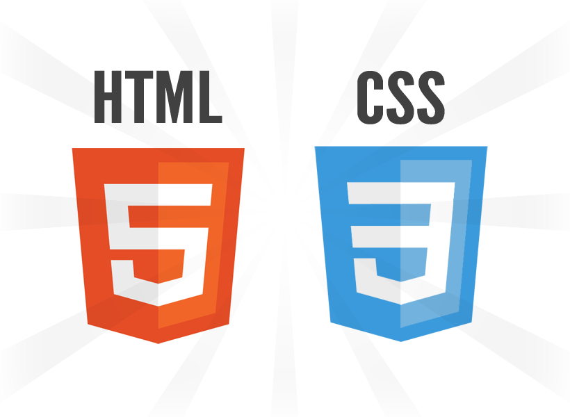
What language is a website written in?
…and JavaScript
Notes:
What do this have to do with computer and coding?
Coding is the art of writing a program for the a computer. The computer will do exactly what you tell it to do. Just like the PBJ activity, it will literally do what you tell it to do, even if that is wrong!

Slide 9
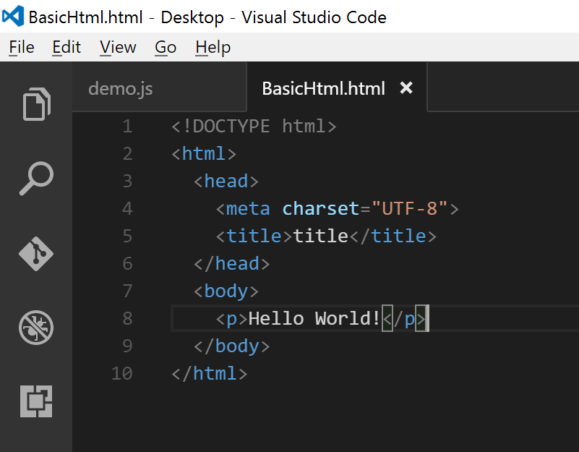
What is HTML
HTML is the basic layout for your Webpage.
All content (text, images, layout, and everything) is in HTML.
Tag is an enclosing element that tells the web browser what you are trying to render
There are many tags that represent different things.
<p></p> (Text)
<h1></h1> (Big header)
<img> (Image)
Notes:
Show BascHtml.html

Slide 10
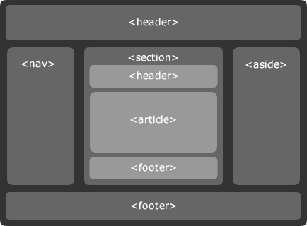
How does text == webpage?
Everything comes down to a type of grid.
HTML works top down.
The web browser will render the tags into text and images
<div> tags, like an invisible box that wraps everything!

Slide 11
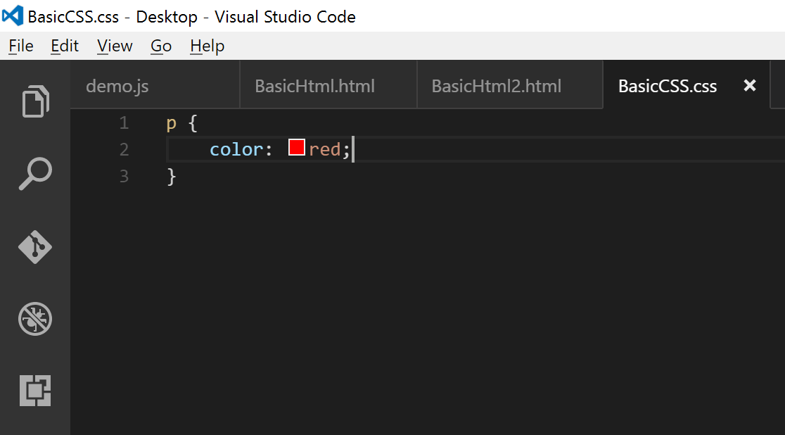
CSS
CSS is the styling and colors of a web page
A lot of this is done automatically with Bootstrap (will talk about soon!)
Notes:
BasicHtml2.html

Slide 12
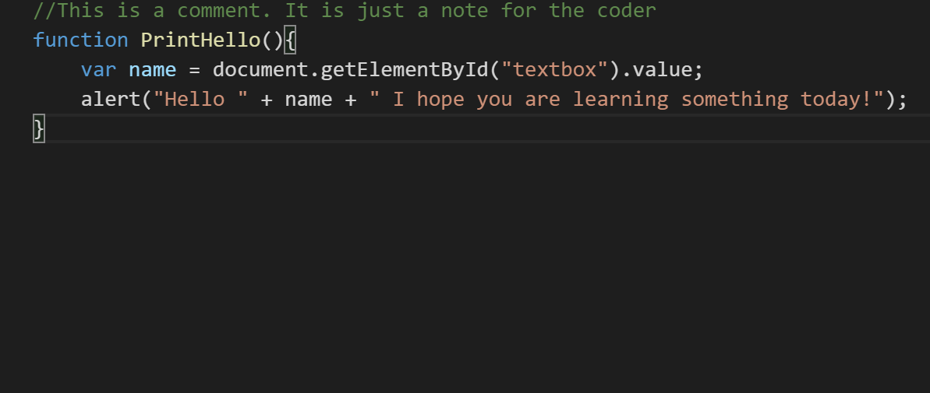
JavaScript
JavaScript, is the most similar to most computing languages like Java, C#, Python, C++/C.
JS adds logic and interaction to your website!
Notes:
BasicHtml3.html

Slide 13
All of this is HARD!
All of this styling is hard!
How do you change sizes, fonts, colors
How do you make it look good on a phone?
Tons of frameworks and libraries!
We will be using Bootstrap: http://getbootstrap.com/

Slide 14
Bootstrap
Bootstrap is the most popular HTML, CSS, and JS framework for developing responsive, mobile first projects on the web.
Makes CSS way easier
Makes a resizable 12 column grid for your website
Give you icons to use
Example: https://www.lyft.com/
Notes:
Go over example/index.html

Slide 15
Let’s build a website!

Slide 16
First off!
Go to https://github.com/rwedoff/BasicCodingWorkshop
This site has all of the info tonight and the boiler plate code.
You can delete all the stuff except for the “Website” folder
I will walk through the next steps!

Slide 17
Let’s Go!
Let’s build this sucker!
I will walk you though the steps!

Slide 18
More Resources
Bootstrap: http://getbootstrap.com/components/
W3Schools: http://www.w3schools.com/html/default.asp
Codecademy: https://www.codecademy.com/
Microsoft Imagine: https://imagine.microsoft.com/en-us
Microsoft Virtual Academy: https://mva.microsoft.com/

Slide 19
Contact Me!
Microsoft Student Partner Group for The University of Iowa
Email Me: ryan.Wedoff@studentpartner.com
Ryan-Wedoff@uiowa.edu

Slide 20
Thanks for coming!

